Slide 1

A Feasibility Study to Measure Public Funding of R&D to Universities & Nonprofits Using Administrative Data
(Today's focus is on Science & Engineering funding to Universities)
9 August 2019

Slide 2
The NCSES UVA Team
NCSES
John Jankowski
Chris Pece
Audrey Kindlon
Gary Anderson
UVA
Stephanie Shipp
Sam Cohen
Joel Thurston
Alyssa Fowers
Sean Pietrowicz

Slide 3
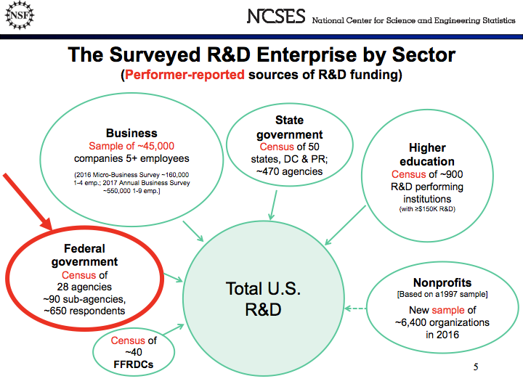
Notes:
The NSF collects data from all sectors about their sources of R&D funding. They collect this data using surveys and censuses. We are interested in assessing the feasibility of measuring federal public funding of R&D to universities and nonprofit organizations using administrative data in place of a survey of federal agencies. (In this case, it is actually a census because all agencies are included.)

Slide 4
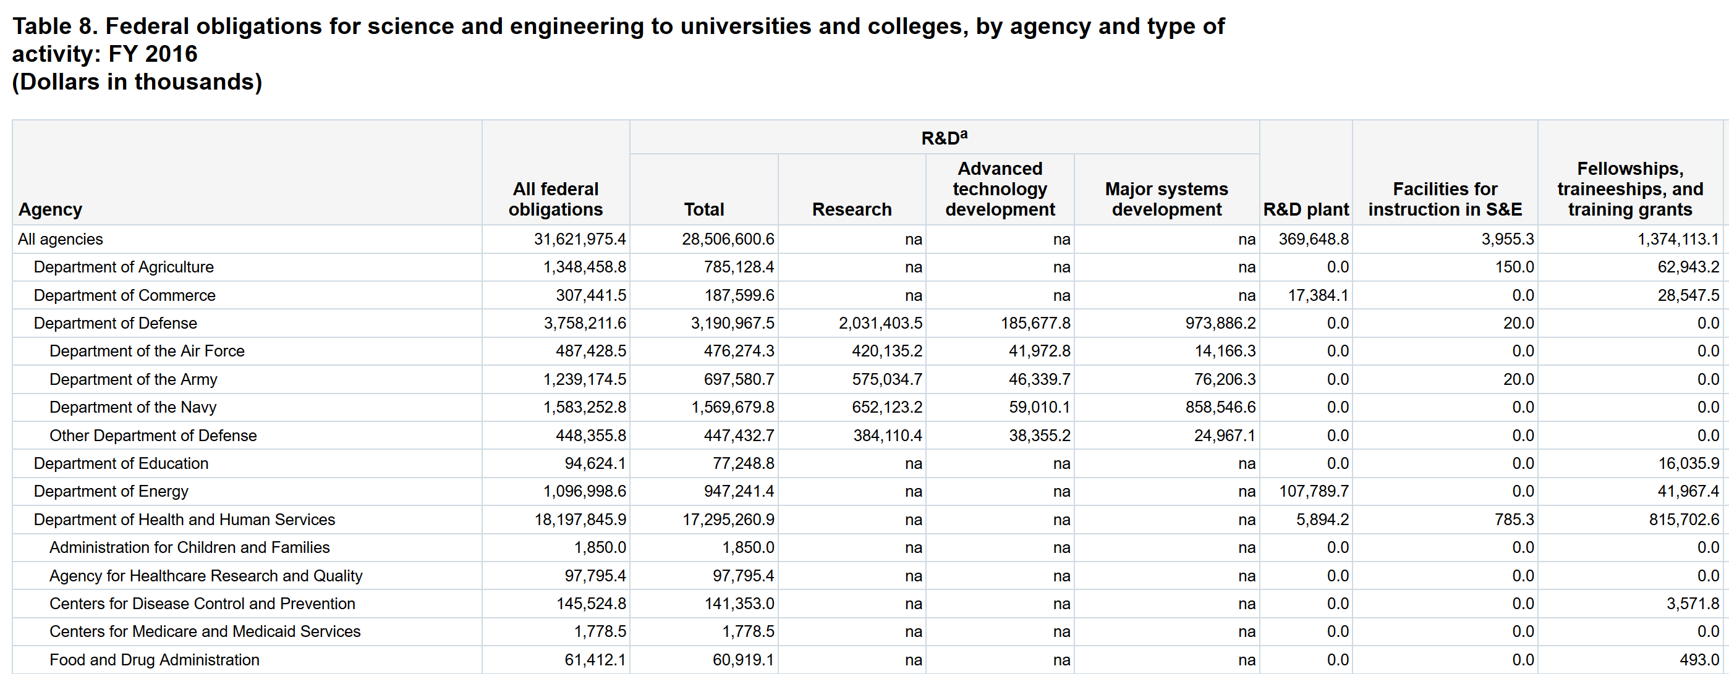
Can we measure R&D at micro level using administrative data?
https://ncsesdata.nsf.gov/fedsupport/2016/html/FSS2016_DST_08.html
Notes:
Can we replace survey data with administrative data?
Motivate: These are the sort of outputs produced by the FSS. Could we produce something similar relying solely on publicly available information? How else can we use data science to complement the findings of FSS, such as offering greater granularity? Compiling all abstracts into a location so that the public could see the use of funds more clearly?

Slide 5
Project Summary and Goals
Enhancing or supplementing research and development data
NSF National Center for Science & Engineering Statistics (NCSES) survey (census) data with publicly available administrative data
Providing International Standards for Science, Technology, Innovation (STI) Data
Organisation for Economic Co-operation and Development (OECD) - National Experts on Science and Technology Indicators (NESTI): – our NSF sponsor chairs this working group
Why this matters
Tracking funding to the project level will allow detailed analysis of R&D funding (fields of study, amount of funding, other)
Goals
Document availability and quality of administrative data to measure public R&D expenditures across federal agencies using a common template.
Assess feasibility of building a micro database of public funding for R&D projects based on administrative data
Notes:
Focus on enhancing or supplementing the NSF National Center for Science & Engineering Statistics (NCSES) survey data with publicly available administrative data to better measure public research and development (R&D) projects.
Also of interest to OECD-NESTI: Providing International Standards for Science, Technology, Innovation (STI) Data – our sponsor chairs this working group
Why this matters:
Although federal funding information of public R&D is documented until the agency level, tracking funding to the project level will allow analysis of projects (fields of study, amount of funding, other)
Goals:
Provide documentation about public R&D expenditures across federal agencies using a common template.
Assess feasibility of building a micro database of public funding for R&D projects based on open and available administrative data
Federal R&D data is reported based on high-level, aggregated survey results, so it’s challenging to investigate specific research topics over time, e.g. how much funding is allocated to nanotechnology projects?
This project will allow the NCSES to learn about the feasibility of accessing and analyzing non-survey data about public R&D.
By consolidating screening and organizing R&D funding information into a common template, NCSES can analyze the extent of investment into specific scientific fields.

Slide 6
What is R&D and S&E?
Research and Development (R&D): Basic and applied research and technological developments
Excluding R&D plant for now
Science and Engineering (S&E): scientific activity including R&D
Including training, conferences, career pipelines, teaching and fellowships
Source: National Science Foundation, National Center for Science and Engineering Statistics, Survey of Federal Science and Engineering Support to Universities, Colleges, and Nonprofit Institutions (FSS)

Slide 7














Focus is on the six agencies compromising the majority of R&D funding

Slide 8
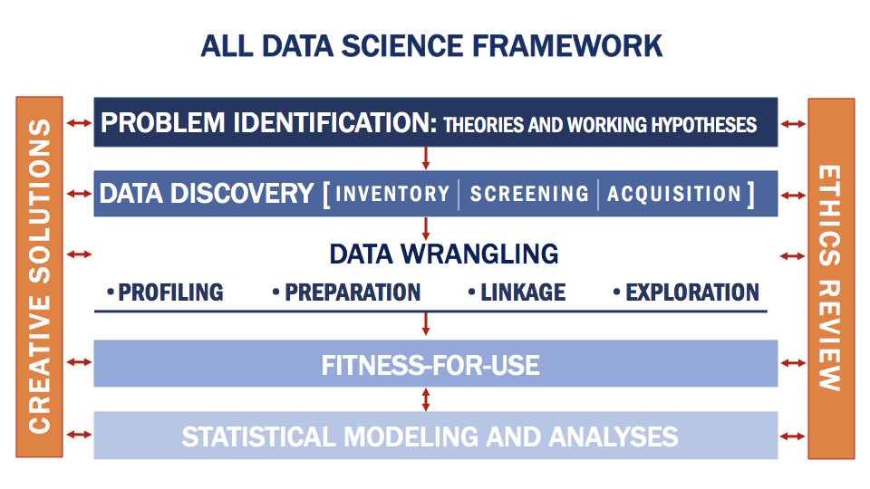

Data Discovery & Screening
Asked 27 screening questions of 11 publicly available databases (handout)
Good date coverage, some direct downloads available, detailed information about agencies funding of R&D and S&E

Slide 9
Data screening suggests no “perfect” data source
Ease of obtaining/ interpreting data
Matching to survey data
Enabling detailed analysis
Basic information
Data dictionaries
Linked to publications
R&D vs general S&E
Basic vs applied research
Grants vs cooperative agreements
Institution type
Notes:
Asked 27 screening questions of 11 publicly available databases.
Good date coverage, some direct downloads available, detailed information about areas of inquiry and research institutions.
Hand out available

Slide 10


Data Discovery
Each agency has some amount of coverage in our data sources, but we are still evaluating the completeness of that coverage.
Energy
Defense
Source
USA Spending
Federal Reporter
Current Research Information System
Conservation Innovation Grants project list
NIH Project Exporter
Conservation Innovation Grants All Project List
NSF Award Search
Office of Science Awards
DOE Public Access Gateway for Energy & Science (PAGES)
ARPA-E Projects
Total Potential Data Sources | 4 | 2 | 2 | 3 | 3 | 5

Slide 11
Data Profiling Example #2
Example Project from Sub-Agency | Award Code (Notation in USA Spending)
DOD – CDMRP The Role of Desert-Dust Metals in the Pathobiology of Gulf War Illness | W81XWH1620050
HHS – NIH VACCINE AND CELL THERAPY CORE LABORATORY | P30CA016087
USDA – ARS Crop and Water Sustainability in Upper Mississippi River Basin Agroecosystems | 58-5030-5-080-1
DoD Activity Address Code
National Cancer Institute Funding
Project conducted through NLAE in Ames, IA

Slide 12
Linking Project Codes
Not only do projects have vastly different notations across each sub-agency, but the same project can have different codes depending on the database, each containing more embedded information.
Example project from Agency/Sub-Agency | USA Spending Notation | Federal Reporter Notation
DOD – CDMRP The Role of Desert-Dust Metals in the Pathobiology of Gulf War Illness | W81XWH1620050 | GW150034
HHS – NIH VACCINE AND CELL THERAPY CORE LABORATORY | P30CA016087 | 4P30CA016087-36
USDA – ARS Crop and Water Sustainability in Upper Mississippi River Basin Agroecosystems | 58-5030-5-080-1 | ARS-0429067
DoD Activity Address Code
Gulf War Illness Research Program
National Cancer Institute Funding
Request for additional years of funding
Project conducted through NLAE in Ames, IA
USDA Accession Number

Slide 13
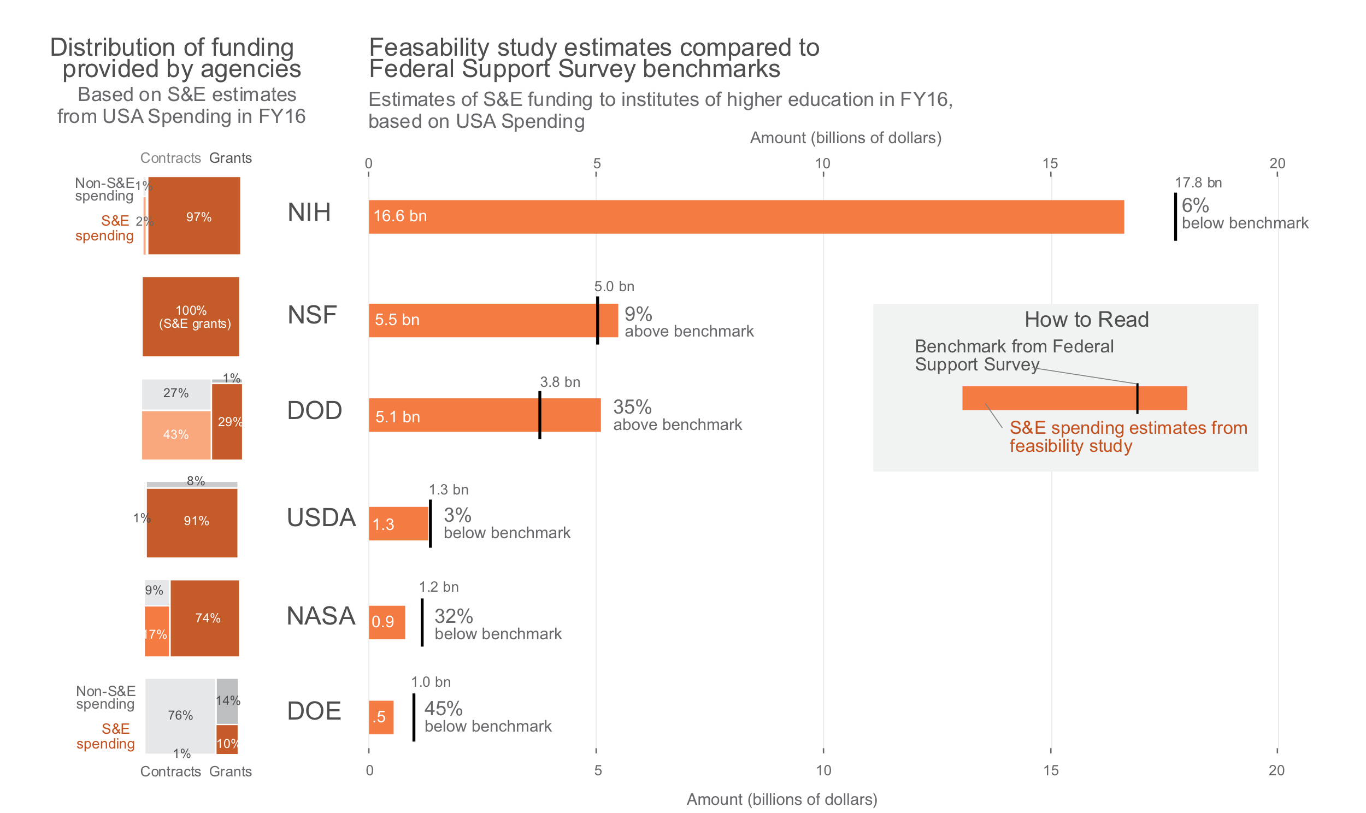
FSS Result is S&E total – R&D Plant

Slide 14


Slide 15
Thank You!

